Slide 1
Deployment and Operations for Software Engineers 2nd Ed
Chapter 11 – Deployment pipeline 1a

Slide 2
Outline
Overview
Environments
Development environment
Integration environment
Staging environment
Deployment
2

Slide 3
Overview of a deployment pipeline
The deployment pipeline is the sequence of actions that move the code you write into production.
We will present it as four stages – development, integration, staging, production.
Integration is also called build.
Organizations vary these stages
Some have no staging
Some hage multiple staging
Each stage has a separate environment—separated from other environments
3

Slide 4
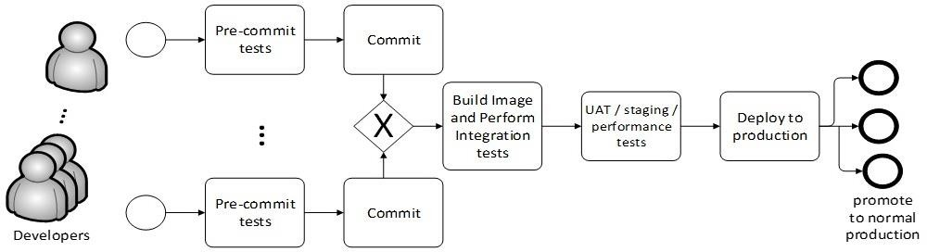
Deployment pipeline
4

Slide 5
Types of tests
One purpose of each environment is to perform tests. Two types of tests can be used
Runtime tests
Static Analysis

Slide 6
Runtime tests
The portion of the system being tested is executed and a set of tests are run on it. This requires a test harness.

Slide 7
Static analysis
This type of testing is applied to the source code. Using techniques similar to those used in compilers, a static analyzer looks for problematic code constructions. Static analyzers have both false positives and false negatives. The type of problems flagged by a static analyzer are those that can be found in the Common Weakness Enumeration CWE).
The CWE is a list of software weakness types..

Slide 8
Development environment overview
In the development environment, you develop your modules.
Unit tests are run on each module.
The module is checked into the version control system. This triggers the integration stage.

Slide 9
Build/integration environment overview
The build server compiles your new or changed code,
It also compiles the code of other portions of your service.
If you are working in an interpreted language such as Python or Javascript, there are no compilation steps.
The build server constructs an executable image for your service.
This executable image is then tested for functional correctness.
After the executable image passes your service’s functional tests, the staging environment is triggered.

Slide 10
Staging environment overview
Tests the quality of the service
performance under load,
security vulnerabilities,
Compliance with regulations and licenses.
User-acceptance testing (UAT) may occur at this stage depending on the business context of your service.
Once the service passes its quality tests it is
Placed into production if you are doing continuous deployment
Marked as ready for deployment if you are doing continuous delivery

Slide 11
Production environment overview
Once in production, the service is monitored closely until there is some confidence about its quality.
At that point, it is considered a normal part of the system and receives the same amount of attention as the other parts of the system.

Slide 12
Qualities of the pipeline
Cycle time
Traceability
Repeatability
Security

Slide 13
Cycle time
Cycle time is the time taken to move through the pipeline.
If humans are involved, cycle time is much increased.
Continuous deployment depends on automated testing.

Slide 14
Traceability
Traceability is the ability track all of the elements of a service in production.
This includes
the code and dependencies that are included in that service.
The test cases that were run on that service
The tools that were used to produce the service.

Slide 15
Traceability
Traceability information is kept in an artifact database.
code version numbers,
dependency version numbers,
test version numbers,
tool version numbers.

Slide 16
Repeatability
Repeatability means that if you perform the same action with the same artifacts, you should get the same result.
This is not as trivial as it sounds. For example,
Your build process fetches the latest version of a dependency. The next time you execute the build process, a new version of the dependency may have been released.
One test modifies some values in the database. If the original values are not restored, subsequent tests will not produce the same results.

Slide 17
Flaky tests
Sometimes tests are not repeatable for a different reason. So called flaky tests.
One cause could be parallelism in the system. Two different executions of a test could take different paths because of timing differences with parallel threads.
Log examination is a method for resolving flaky tests.

Slide 18
Security
15-20% of security breaches are caused by insiders.
Techniques to reduce the possibility of an insider attack on the pipeline are
Limiting access to the pipeline tools,
keeping a record of changes and the originator of the changes,
Notifying team members that a pipeline tool has been updated or modified.

Slide 19
Discussion questions
What are the tradeoffs between doing quality testing in the integration step and doing it in a separate staging step?
What is the relation between cycle time and the number of deployments per day?

Slide 20
Outline
Overview
Environments
Development environment
Integration environment
Staging environment
Deployment
20

Slide 21
Purpose of an environment
The purpose of each environment, except for production, is to provide a place to perform testing that is isolated from other development or testing activities that might be ongoing.
The production environment is treated differently.

Slide 22
Requirements for an environment
The environment is isolated from other environments. Including
address spaces
inputs
modifications to any database
other dependencies on the processes being executed in the environment.

Slide 23
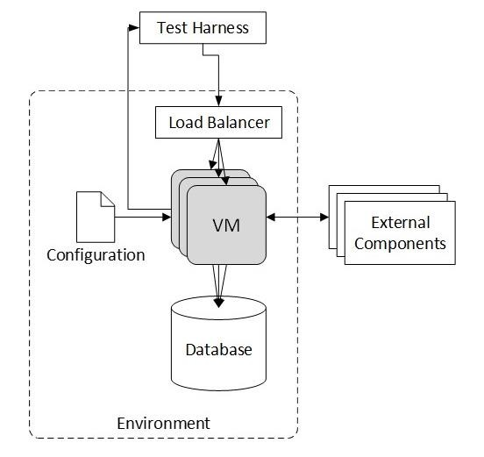
Elements of the environment
collection of virtual machines or containers
infrastructure services (for example, a load balancer)
a source of input for runtime tests
a database
configuration parameters
external services

Slide 24
Collection of Virtual Machines or Containers
The modules, services, or system being executed in this environment.
The collection of services in the environment grows as the system moves through the pipeline.
In a development environment, a single module is being tested;
in an integration environment, the service is being tested;
in a staging environment, the service plus other services is tested.

Slide 25
Infrastructure Services
Your service depends on infrastructure services.
In the development environment, you may need only a load balancer and logging,
In other environments you may need services such as registration and discovery.

Slide 26
Source of input
The purpose of each environment is to run tests, and tests require a source of input.
The input can come from
a test harness or dynamic workload generator
from live users
by replaying a previously captured input from live users.

Slide 27
Database
The database must be restored after each test.
The tests must be repeatable and give the same results every time they are run.
Any given test may modify data in the database. Restoring the database after each test ensures that each execution of each test begins from the same state.

Slide 28
Configuration Parameters
A configuration parameter is a value that is bound at runtime,
Each environment will have a set of configuration parameters
The configuration parameters will vary from environment to environment.

Slide 29
External Services
External services can range from a service that broadcasts the weather to one that performs authorization.
The treatment of these external services depends on which environment your service is in and whether the external service is read only or read/write.
If your service is not in the production environment and the external service is read/write, it must be stubbed or mocked.

Slide 30
Life cycle of an environment
An environment has a finite lifetime
Created
Used
Cleaned up
Creation and clean up can be automated

Slide 31
Create
The creation of an environment is triggered by some event.
Which event depends on the purpose of the environment

Slide 32
Actions of the create step
Create a VM or container loaded with your software.
Create a load balancer. The load balancer is a separate VM or is allocated from a PaaS or service mesh.
Create the test harness.
Initialize the database for the environment.
Create environment-dependent configuration parameters

Slide 33
Usage
Usage will vary depending on the purpose of the environment.

Slide 34
Clean up
Save any persistent artifacts created by the environment.
Adjust any necessary data.
Remove any resources created.

Slide 35
Variations
Other variations on the pipeline stages include
Test a complete service in the development stage (rather than just your own module), and then test the entire system (your service integrated with other services) in the integration stage.
Quality testing that we describe in staging is performed in the integration step
The integration stage might test “typical” customer use cases
Multiple staging environments exist for different purposes

Slide 36
Discussion questions
Would UAT testing be done in a separate staging environment or the normal staging environment? How would you do UAT testing with real users?
Where does the data in the test database come from?

Slide 37
END of Part 1a of Chapter 11

